Slide 1
Feeder Birds to Know
Spring

Slide 2
Resident Review - Black Birds

Slide 3
Resident Review - Blue Birds

Slide 4
Resident Review - Song Birds

Slide 5
Residents to know - Other

Slide 6
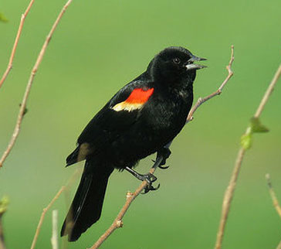
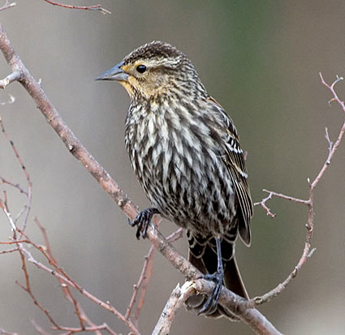
Red-Winged Blackbird
Notes:
Color Pattern Male Red-winged Blackbirds are hard to mistake. They're an even glossy black with red-and-yellow shoulder badges. Females are crisply streaked and dark brownish overall, paler on the breast and often show a whitish eyebrow.
Behavior Male Red-winged Blackbirds do everything they can to get noticed, sitting on high perches and belting out their conk-la-ree! song all day long. Females stay lower, skulking through vegetation for food and quietly weaving together their remarkable nests. In winter Red-winged Blackbirds gather in huge flocks to eat grains with other blackbird species and starlings.

Slide 7
Varied Thrush
Notes:
Varied Thrushes hop on the ground or low in shrubs and trees. They eat mainly insects and other arthropods in the summer and switch to nuts and fruit in fall and winter. On breeding territories, male Varied Thrushes sit on exposed perches to sing their haunting, trilling songs.
Habitat Varied Thrushes breed in dark understories of humid evergreen and mixed forests along the Pacific Coast. In the winter, many move into dense parks, gardens, and backyards. Varied Thrushes are rare but regular winter visitors to the Upper Midwest and Northeast.

Slide 8
Killdeer
Notes:
A shorebird you can see without going to the beach, Killdeer are graceful plovers common to lawns, golf courses, athletic fields, and parking lots. These tawny birds run across the ground in spurts, stopping with a jolt every so often to check their progress, or to see if they’ve startled up any insect prey. Their voice, a far-carrying, excited kill-deer, is a common sound even after dark, often given in flight as the bird circles overhead on slender wings.
Behavior Killdeer spend their time walking along the ground or running ahead a few steps, stopping to look around, and running on again. When disturbed they break into flight and circle overhead, calling repeatedly. Their flight is rapid, with stiff, intermittent wingbeats.
Habitat Look for Killdeer on open ground with low vegetation (or no vegetation at all), including lawns, golf courses, driveways, parking lots, and gravel-covered roofs, as well as pastures, fields, sandbars and mudflats. This species is one of the least water-associated of all shorebirds.

Slide 9
Barn Swallow
Notes:
Glistening cobalt blue above and tawny below, Barn Swallows dart gracefully over fields, barnyards, and open water in search of flying insect prey. Look for the long, deeply forked tail that streams out behind this agile flyer and sets it apart from all other North American swallows. Barn Swallows often cruise low, flying just a few inches above the ground or water. True to their name, they build their cup-shaped mud nests almost exclusively on human-made structures.

Slide 10
Tree Swallow
Notes:
A common swallow of marshes and open fields, the Tree Swallow is a ready inhabitant of nest boxes.
The Tree Swallow winters farther north than any other American swallow, and it returns to its nesting grounds long before other swallows come back.

Slide 11
Golden Crowned Kinglet
Notes:
A tiny, continuously active bird, the Golden-crowned Kinglet is most frequently found in coniferous woods. Despite being barely larger than a hummingbird, the kinglet winters northward to Canada and Alaska.

Slide 12
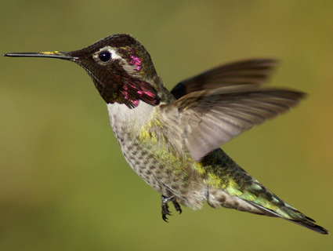
Anna's Hummingbird
Notes:
Anna’s Hummingbirds are among the most common hummingbirds along the Pacific Coast, yet they're anything but common in appearance. With their iridescent emerald feathers and sparkling rose-pink throats, they are more like flying jewelry than birds. Though no larger than a ping-pong ball and no heavier than a nickel, Anna’s Hummingbirds make a strong impression. In their thrilling courtship displays, males climb up to 130 feet into the air and then swoop to the ground with a curious burst of noise that they produce through their tail feathers.

Slide 13
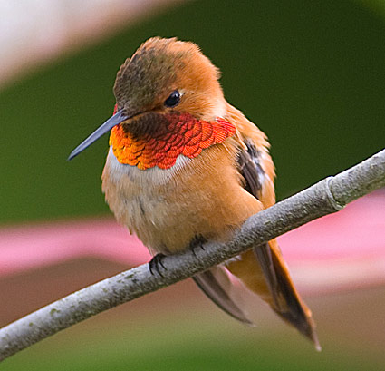
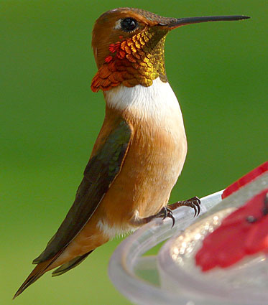
Rofous Hummingbird

Slide 14
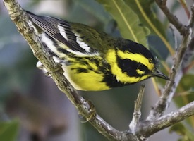
Townsends Warbler
Notes:
the Townsend's Warbler nests in coniferous forests from Alaska to Oregon. It winters in two distinct areas: in a narrow strip along the Pacific Coast, and in Mexico and Central America.

Slide 15
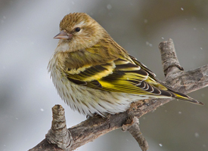
Pine Siskin
Notes:
Flocks of tiny Pine Siskins may monopolize your thistle feeder one winter and be absent the next. This nomadic finch ranges widely and erratically across the continent each winter in response to seed crops. Better suited to clinging to branch tips than to hopping along the ground, these brown-streaked acrobats flash yellow wing markings as they flutter while feeding or as they explode into flight. Flocks are gregarious, and you may hear their insistent wheezy twitters before you see them.
Behavior
Pine Siskins often visit feeders in winter (particularly for thistle or nyjer seed) or cling to branch tips of pines and other conifers, sometimes hanging upside down to pick at seeds below them. They are gregarious, foraging in tight flocks and twittering incessantly to each other, even during their undulating flight.

Slide 16
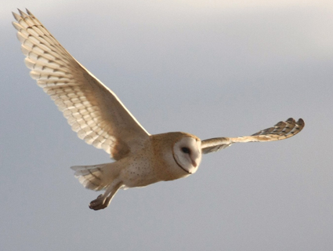
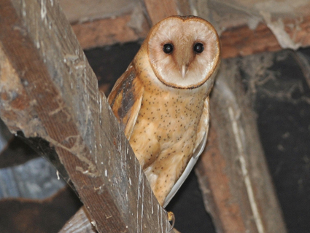
Barn Owl

Slide 17
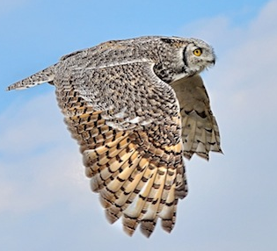
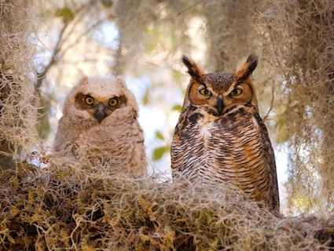
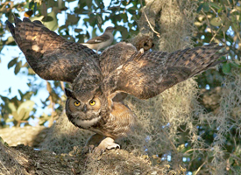
Great Horned Owl

