Slide 1
Simpson's Diversity Index

Slide 2
What it measures
3 separate measures of diversity. We will use Simpson's Reciprocal Index.
2.The higher the D value, the greater the diversity. The lowest D can be is one, and the highest is the number of different species found.

Slide 3
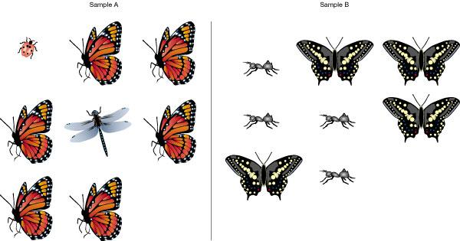
What it measures
c. Diversity is a function of two measures: richness and abundance.
i. Richness is the number of species per sample. Does not consider the abundance of species present.
Ex: One daisy has a much influence on richness as does a patch of 1000 buttercups.
ii. Evenness is a measure of the relative abundance of difference species.

Slide 4
Pair - Share
Two different fields are sampled for wildflowers. The sample from the first field consists of 300 daisies, 335 dandelions and 365 buttercups. The sample from the second field comprises 20 daisies, 49 dandelions and 931 buttercups. Evaluate richness and evenness.

Slide 5
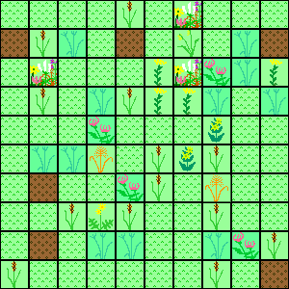
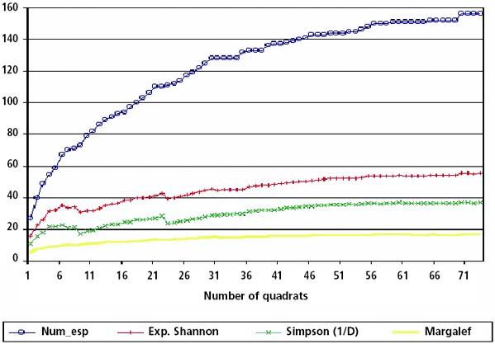
Method
Sample the area using a quadrat
2. To determine the number of samples needed - plot number of species found until the number plateaus ...this indicates your sample size is large enough to be accurate.

Slide 6
Method
3. Record the number of species present (identifying is not necessary as long as different species can be distinguished).
4. Plug numbers into formula.
Index value
D =
N = n =
Σ=
total # of organisms of all species found
number of individuals of a particular species
“Sum of” so add ‘em up

Slide 7
What this tells you
High D.. suggests stable and/or ancient site
Low D...suggests disturbance or limiting factors
Predict the D value for the following situations
- Polluted stream
- Old growth forest
- Area cleared for power lines
- Agricultural area
- Estuary (between river & ocean)
- Our Campus

